Slide 1

Disaster Tweet Classification with BERT
Taraneh Javaherpour
Davood Aein

Slide 2
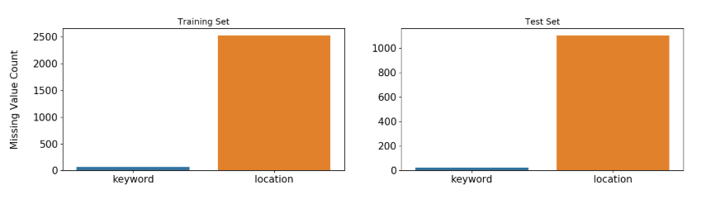
Data Preprocessing – Missing Values

Slide 3
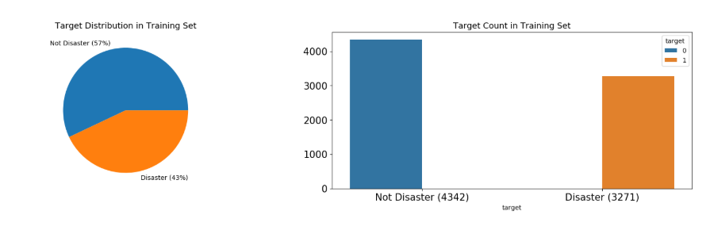
Exploratory Analysis – Target Distribution

Slide 4
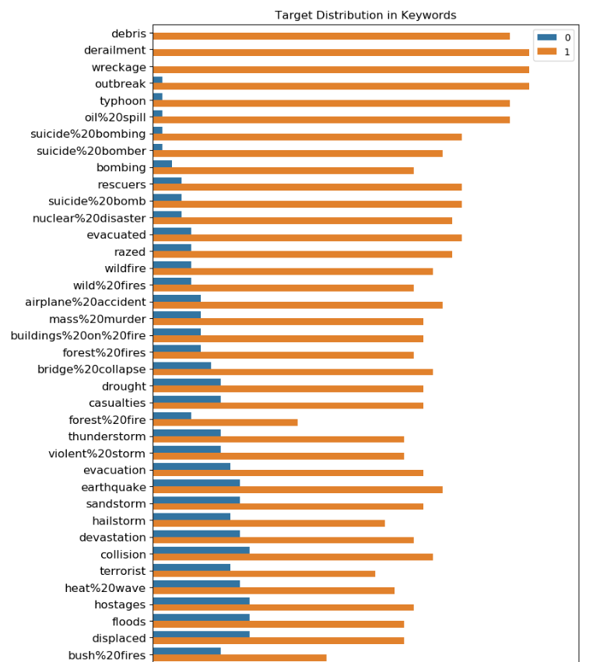
Keyword Analysis & Target by Keyword

Slide 5
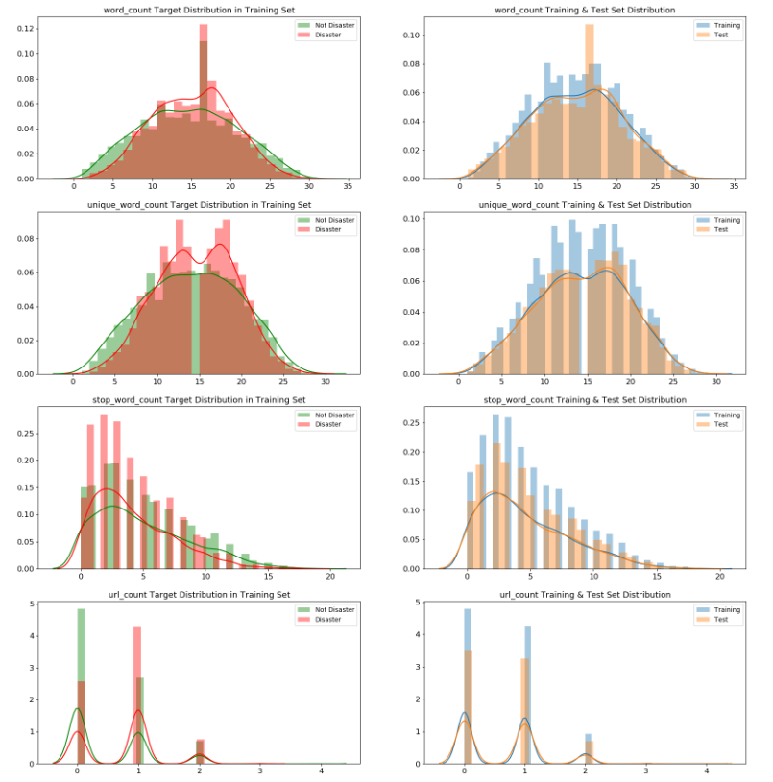
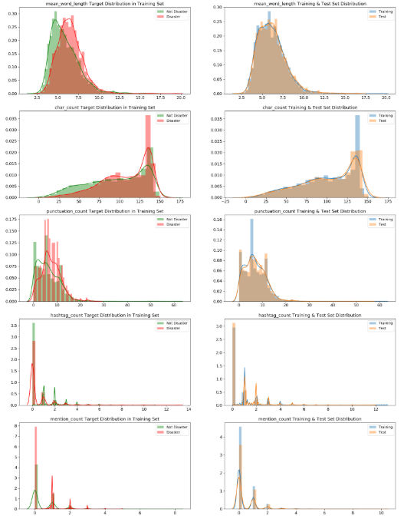
Feature Engineering – Meta Features

Slide 6
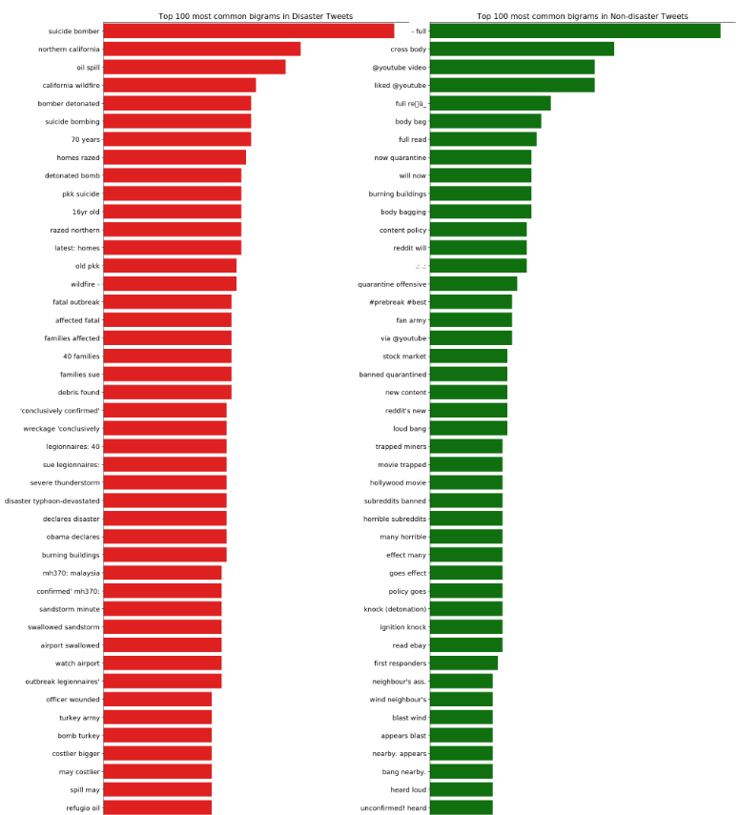
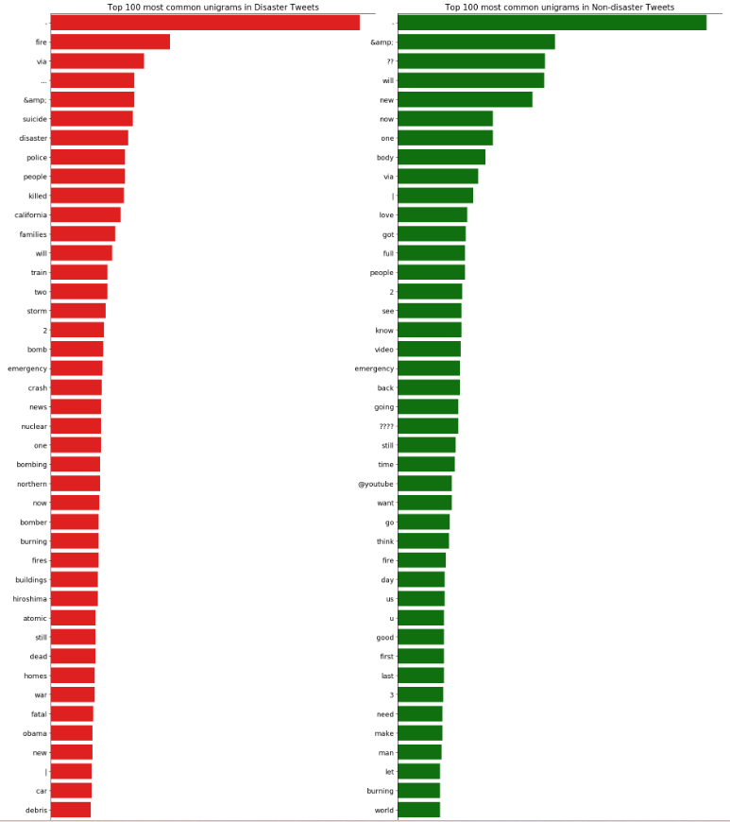
Exploratory Analysis – N-grams

Slide 7
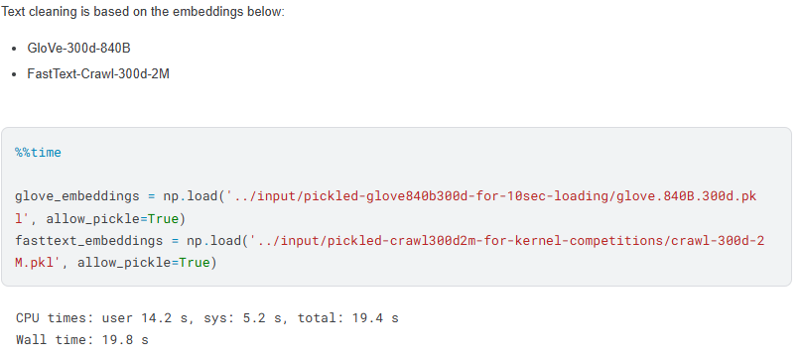
Embeddings & Vocabulary Coverage

Slide 8
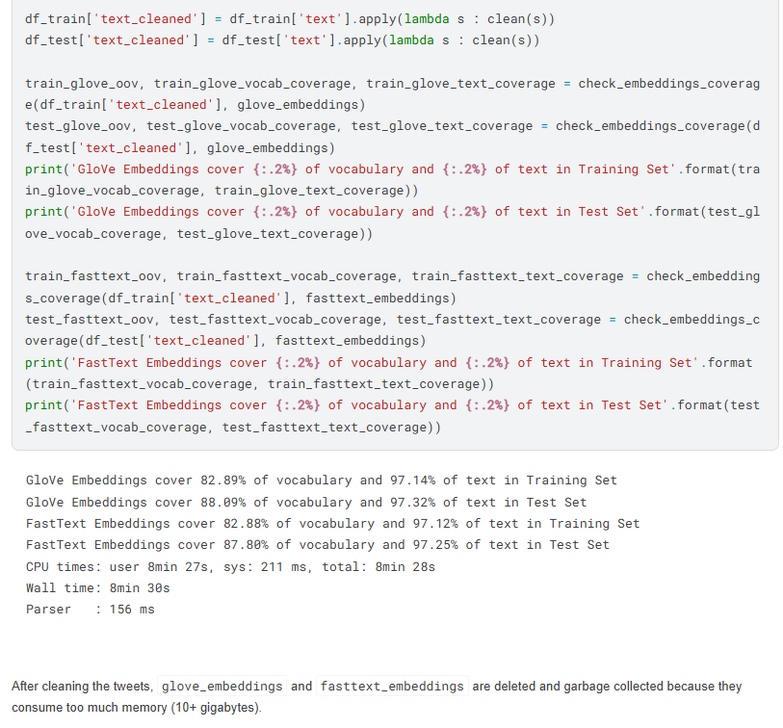
Text Cleaning Strategy

Slide 9
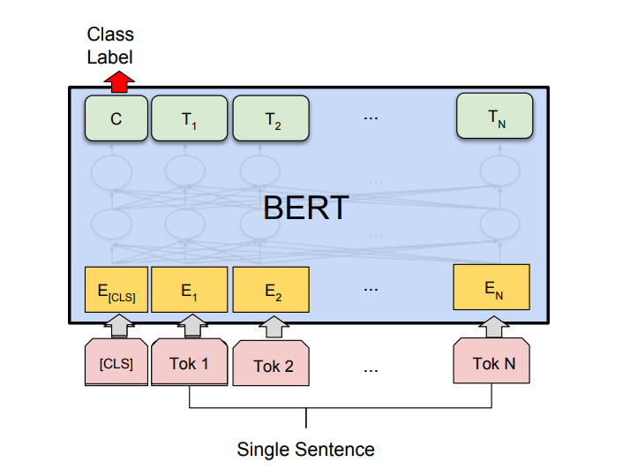
Model Architecture – BERT Classifier

Slide 10
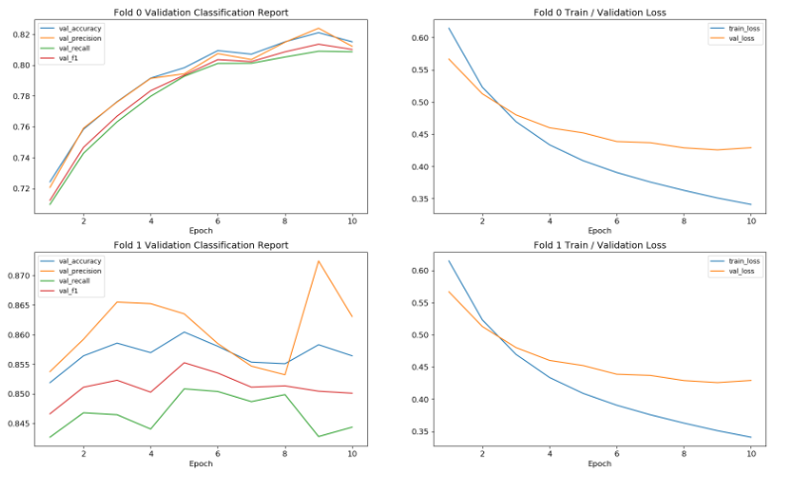
Training Strategy & Hyperparameters, Results

Slide 11

Conclusion

